Slide 1

by, Ashwith Anand Poojary(11038008) Muskaan Chhabra(11038196) Rakesh Hadne Sreenath(11038138) Aadishree Borkar(11037522)
Data Management & Acquisition Project

Slide 2


Table of Contents:
Purpose
About the Dataset
Tools and Technologies
Data Profiling
Data Cleaning
Insight
Data Uncleaning
Conclusion
Reference
8 March 2024

Slide 3
Purpose
As a data analyst working with law enforcement agencies, I want to know,
the count of crimes for each police area name,
identify the most common type of crime,
and determine the average victim age.
This will enable us to prioritize resources effectively and guide law enforcement efforts towards addressing community safety concerns.
8 March 2024

Slide 4

About the Dataset
Crime dataset (2020 to present)
Dataset reflects incidents of crime in the city of Los Angeles from 2020
Data source: DATA.Gov
Data size : 901358 rows and 28 columns
TEAM 6
8 March 2024

Slide 5
Tools and Technologies Used
GCP Data prep
Big Query
Tableau Prep
8 March 2024

Slide 6

User Story
6
As a data analyst for law enforcement agencies:
I want to retrieve crime counts for each police area name, so that we can identify crime hotspots and allocate resources efficiently.
As a law enforcement officer:
I want to know the most common type of crime in each area, so that we can focus our efforts on addressing prevalent criminal activities.
As a community safety advocate:
I want to determine the average victim age for different types of crimes, so that we can tailor prevention and support initiatives to better protect vulnerable demographics.
TEAM 6
8 March 2024

Slide 7
Data Profiling
TEAM 6
8 March 2024

Slide 8
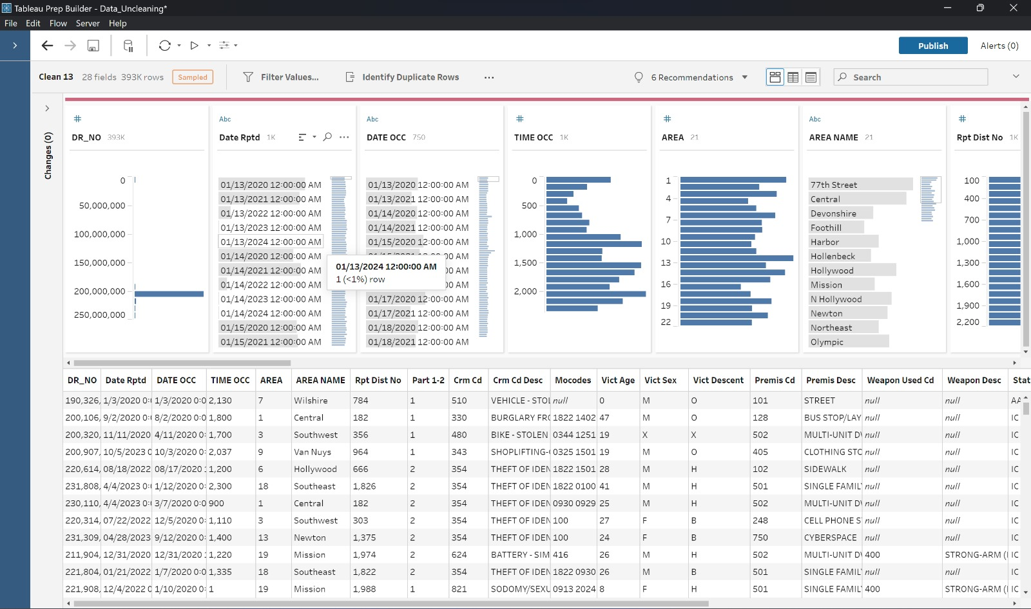
Data Profiling : Single-Column Analysis
Unique Values:
Profiling involves determining the number of unique values for each attribute. This helps in understanding the variety and distribution of data within the dataset.
TEAM 6
8 March 2024

Slide 9
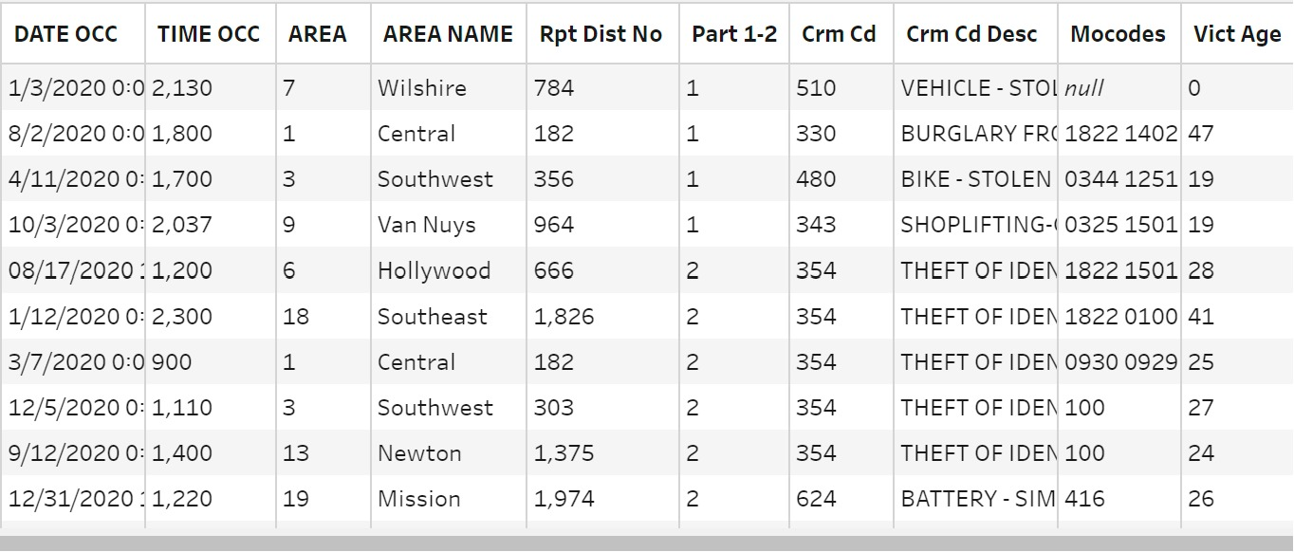
Data Profiling
Data Types:
Profiling also involves Identifying the types of data present in the dataset, such as numeric, text, date, or categorical. Understanding data types is crucial for ensuring appropriate handling and analysis of the data.
TEAM 6

Slide 10
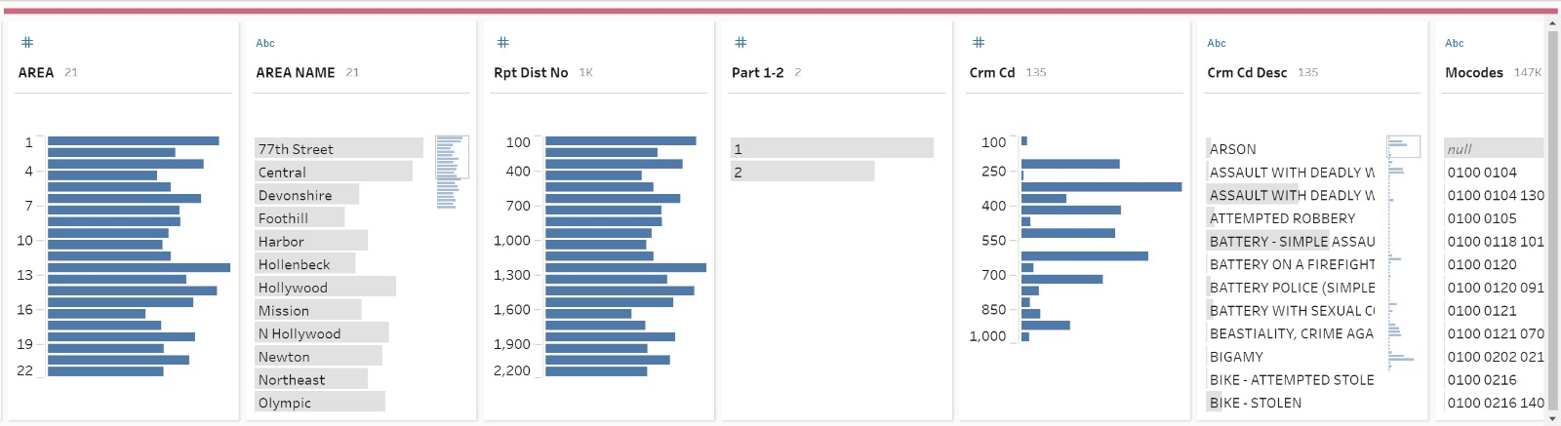
Data Profiling
Value Patterns and Distribution:
Identify patterns and distributions of values within each attribute to gain insights into data characteristics and behavior, so that we can consider which features to consider
TEAM 6
8 March 2024

Slide 11
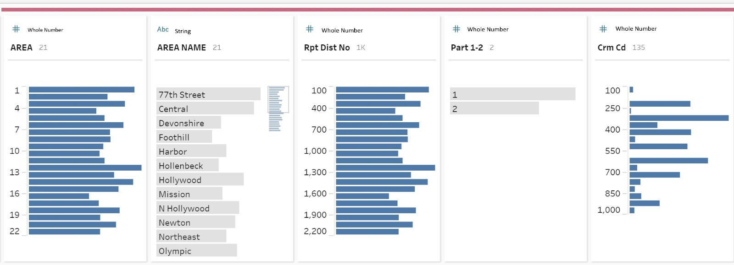
Data Profiling
Accuracy:
Data inaccuracies can lead to misleading analysis results and incorrect conclusions. So, we need to know how well data values reflect the real-world entities or phenomena they represent.
TEAM 6
8 March 2024

Slide 12
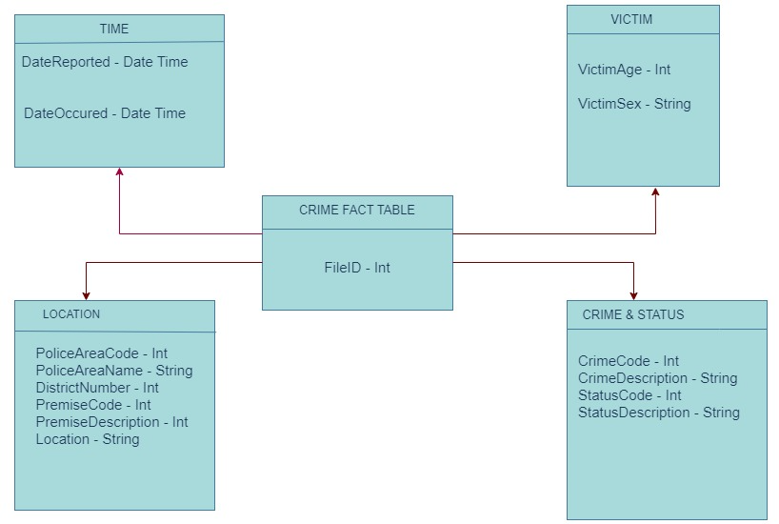
Data Profiling
Structure discovery:
Data profiling is focused on understanding dependencies that delineate relationships among different columns within a dataset.
TEAM 6

Slide 13
Data Cleaning
TEAM 6
8 March 2024

Slide 14
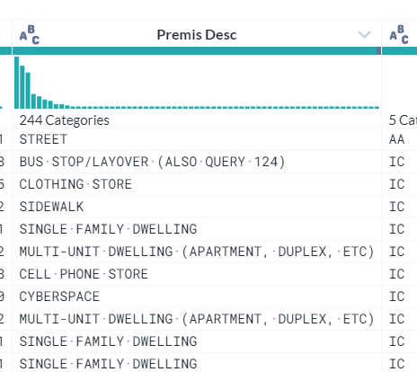
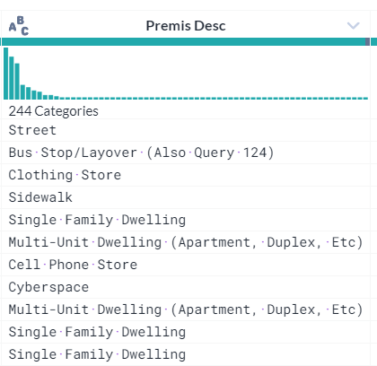
Data Cleaning
Consistency:
Standardize formats and resolve conflicting information.
TEAM 6
8 March 2024

Slide 15
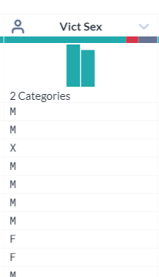
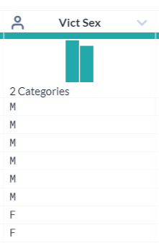
Data Cleaning
Completeness:
Incomplete data may contain missing values or mismatch values and lack certain necessary attributes.
TEAM 6
8 March 2024

Slide 16
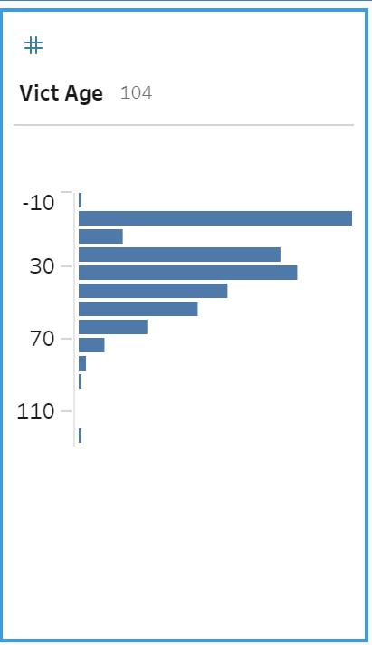
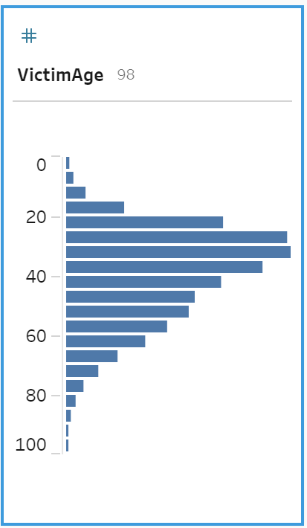
Data Cleaning
Accuracy :
Accuracy in data cleaning refers to the degree to which the data reflects the true values or information it is intended to represent
TEAM 6
8 March 2024

Slide 17
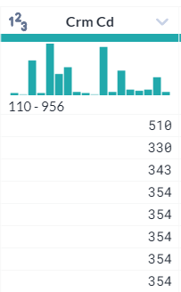
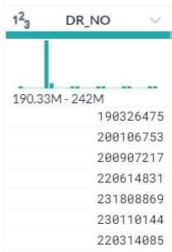
Data Cleaning
Cardinality:
Number of unique values in a column. Analyzing cardinality helps in understanding the diversity and distribution of data within a column.
High cardinality columns may contain mostly unique values and might be suitable for indexing, while low cardinality columns may have a limited set of values and could potentially be candidates for categorization.
TEAM 6
8 March 2024

Slide 18
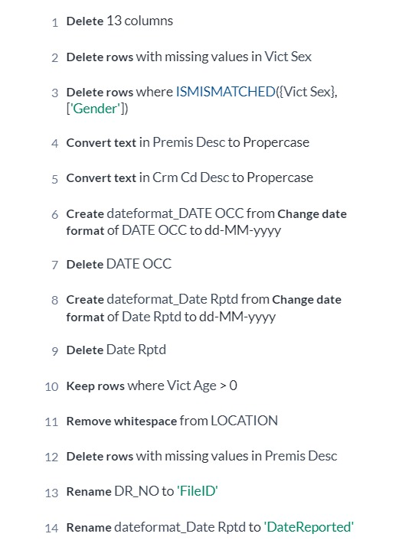
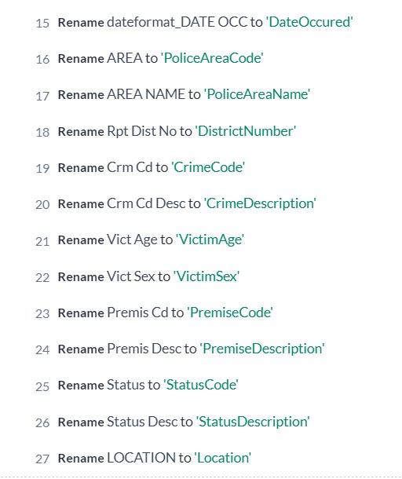
Data Cleaning
Recipe
8 March 2024

Slide 19
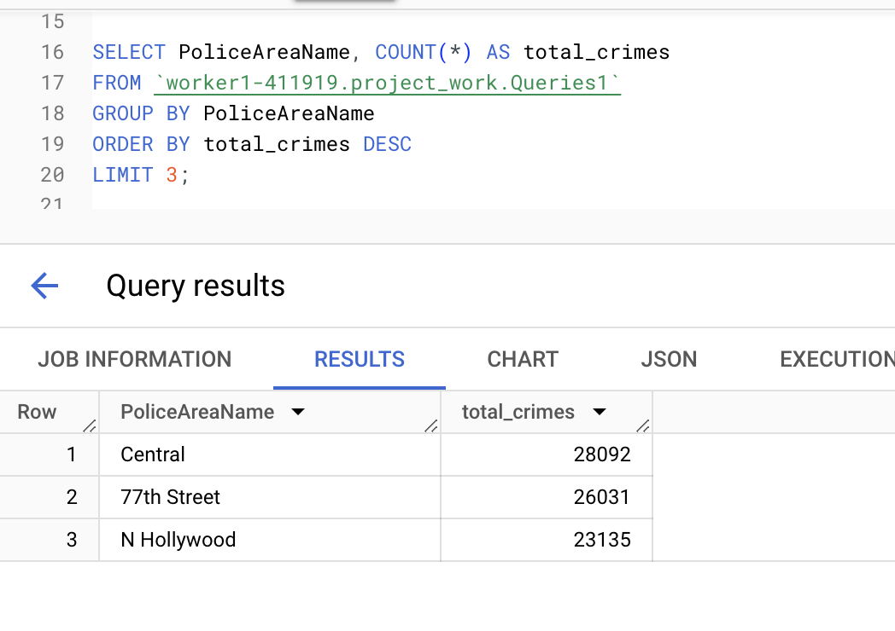
Queries
Retrieving the count of crimes for police area name
TEAM 6

Slide 20
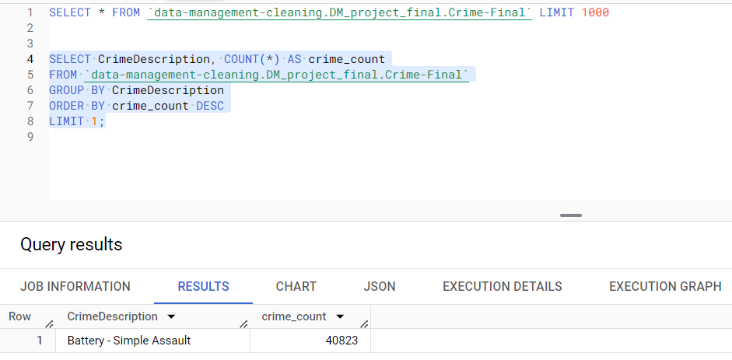
The Most Common Type Of Crime Committed
TEAM 6

Slide 21
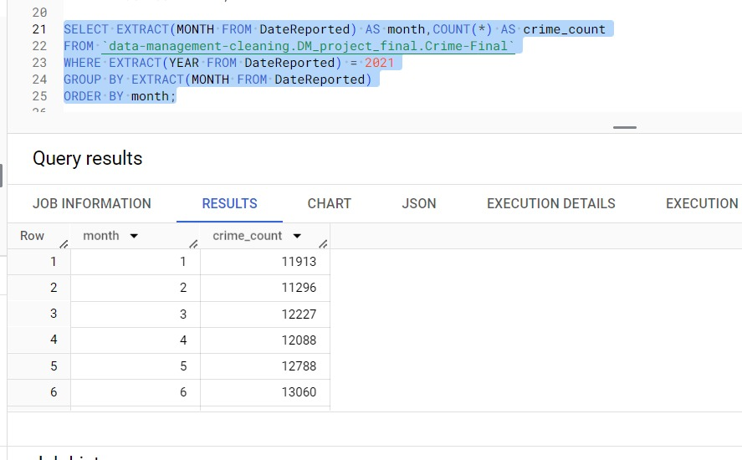
Number Of Crimes In Every Month Of The Year 2021
TEAM 6

Slide 22
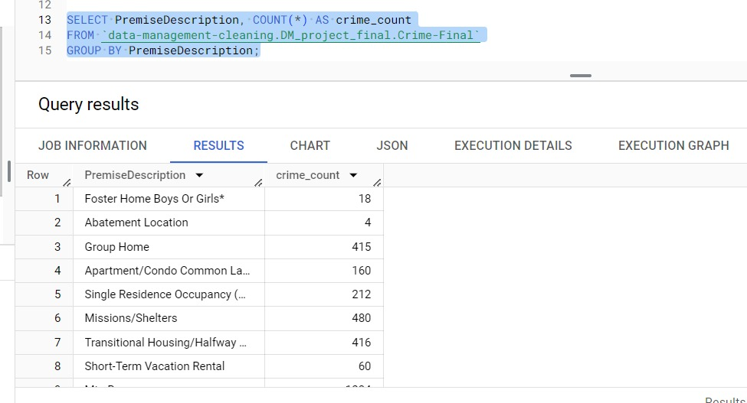
Retrieve The Number Of Crimes Reported In Each Location Type
TEAM 6

Slide 23
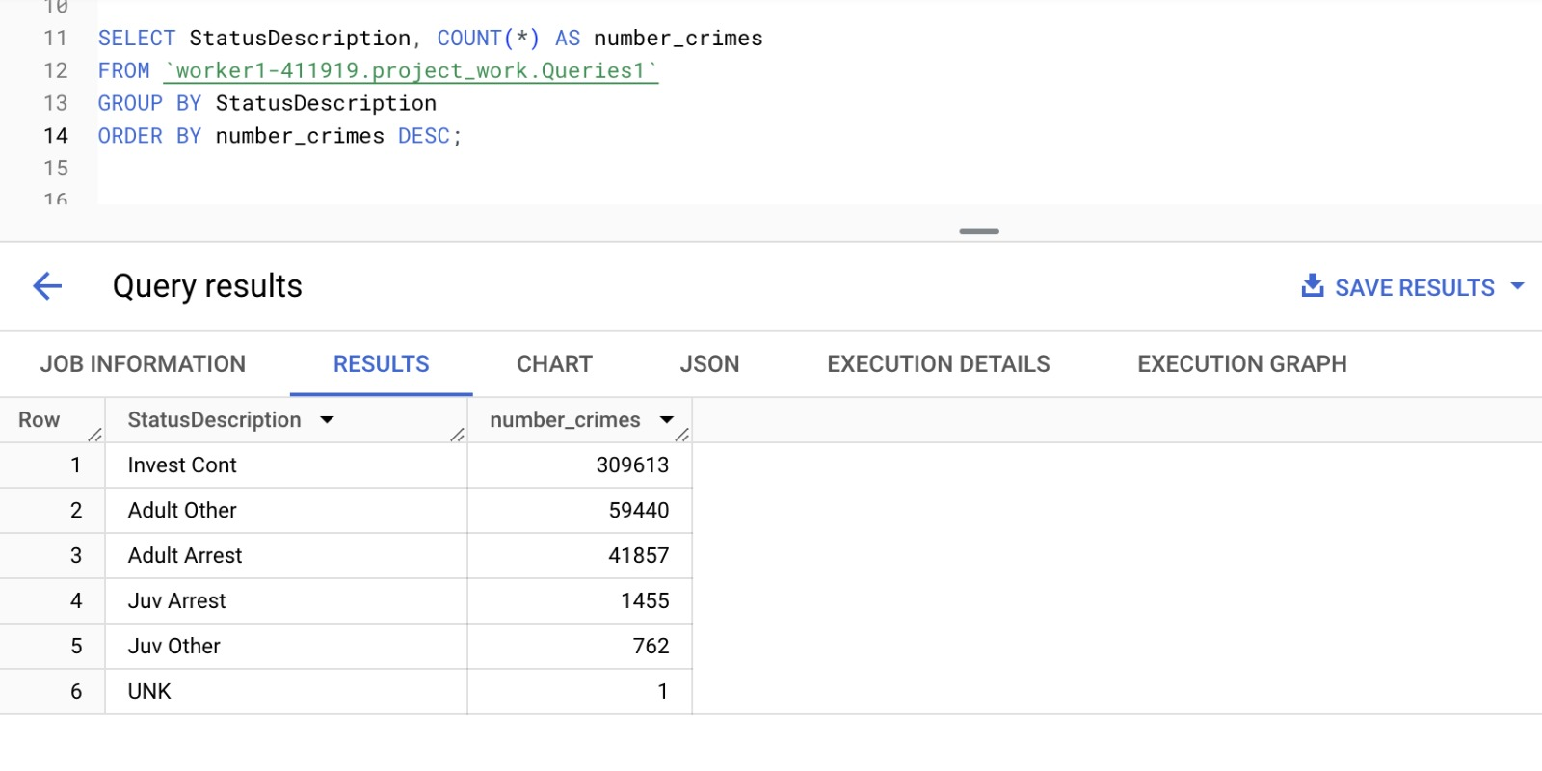
Retrieving the count of crimes grouped by their status descriptions
TEAM 6

Slide 24
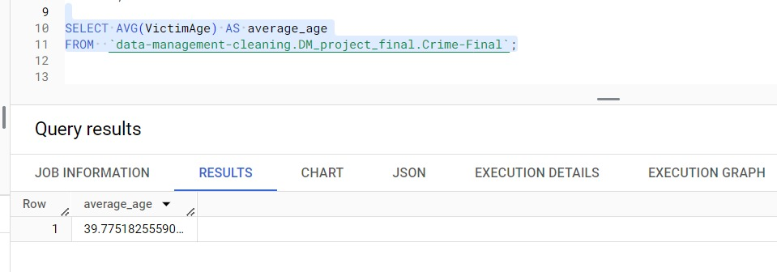
Average age of victims in crimes
TEAM 6

Slide 25
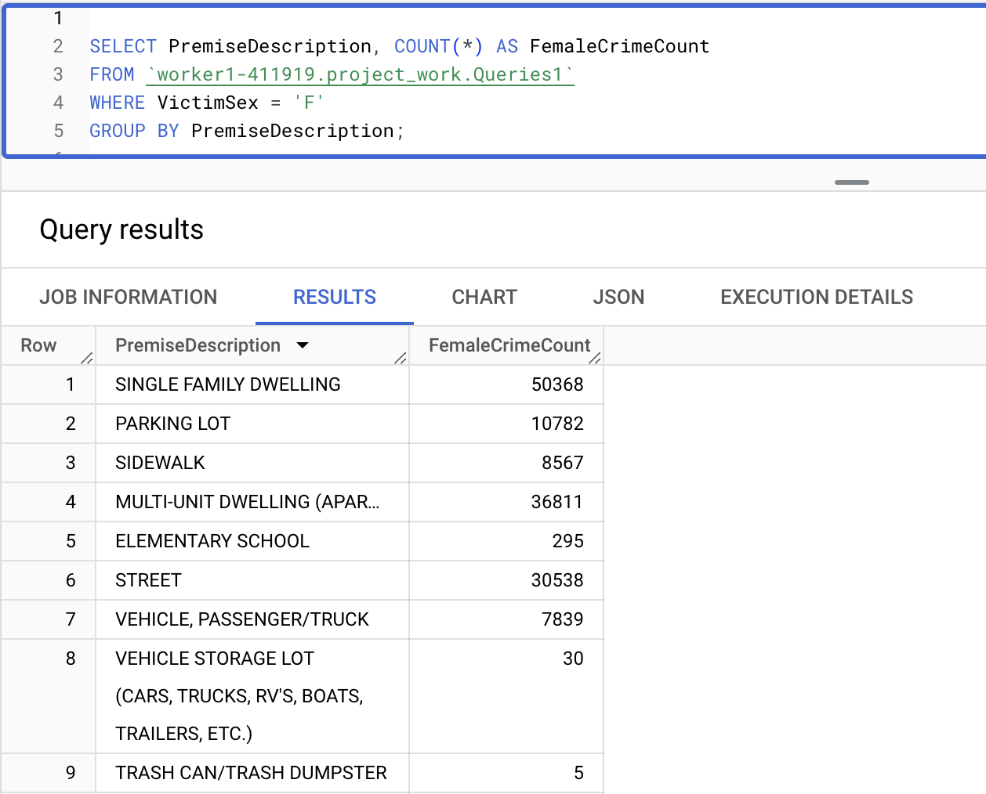
Total count of crimes involving female victims, grouped by each location
TEAM 6

Slide 26
Data Uncleaning
TEAM 6
8 March 2024

Slide 27
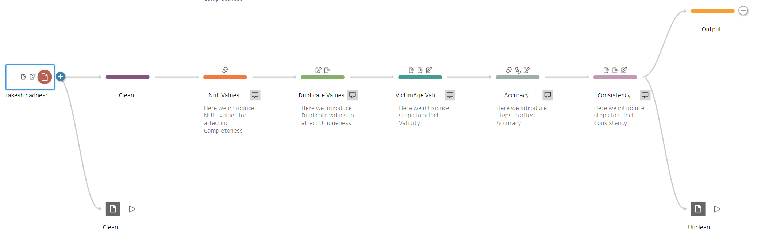
Data Uncleaning
This is the flow of the uncleaning process using TableauPrep Builder.
TEAM 6
8 March 2024

Slide 28
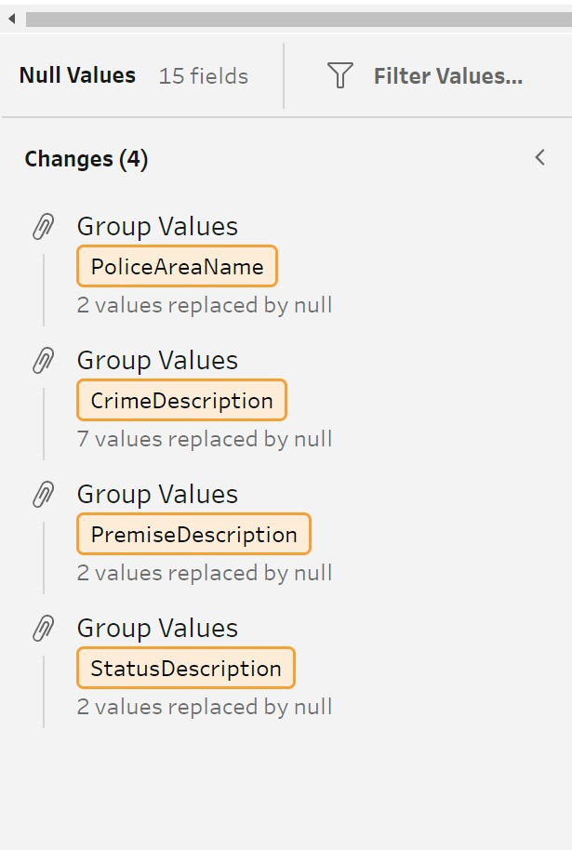
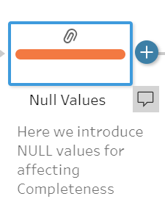
Data Uncleaning
Affecting Completeness:
Adding the null values to different fields
Why is this important?
This impacts the completeness of the dataset and can lead to biased analysis or the inability to make certain inferences.
TEAM 6
8 March 2024

Slide 29
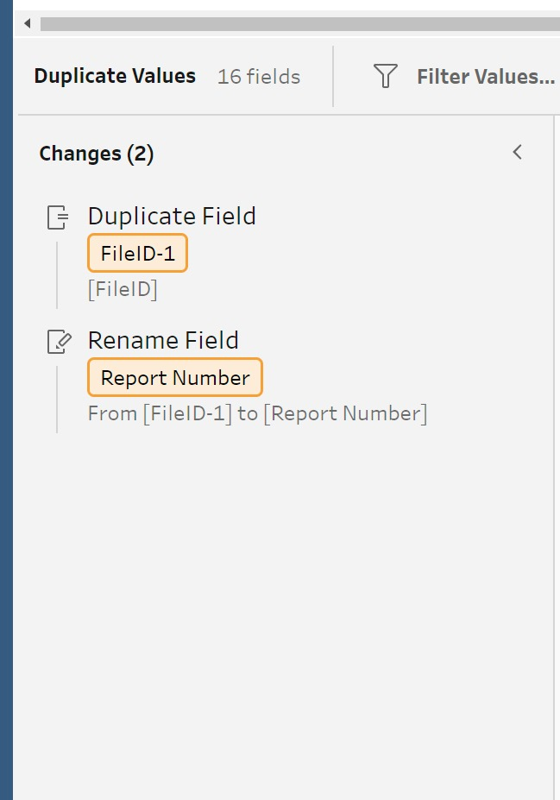
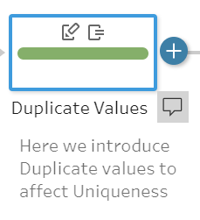
Data Uncleaning
29
Affecting Uniqueness:
-Adding a duplicate field to reduce the uniqueness
Why is this important?
This results in inefficiency in storage and processing and makes it difficult in identifying unique records.
TEAM 6
8 March 2024

Slide 30
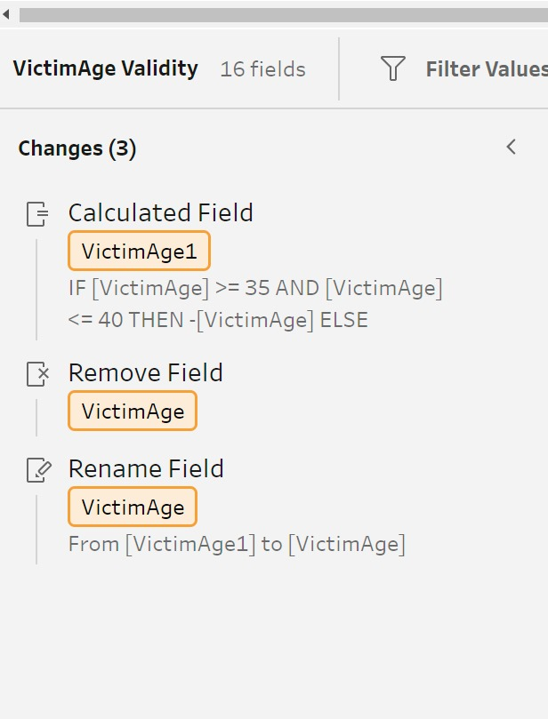
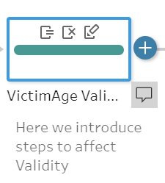
Data Uncleaning
Affecting Validity:
-Adding negative value in age field
Why is this important?
This results in loss of credibility in the data and potential errors in analysis.
TEAM 6
8 March 2024

Slide 31
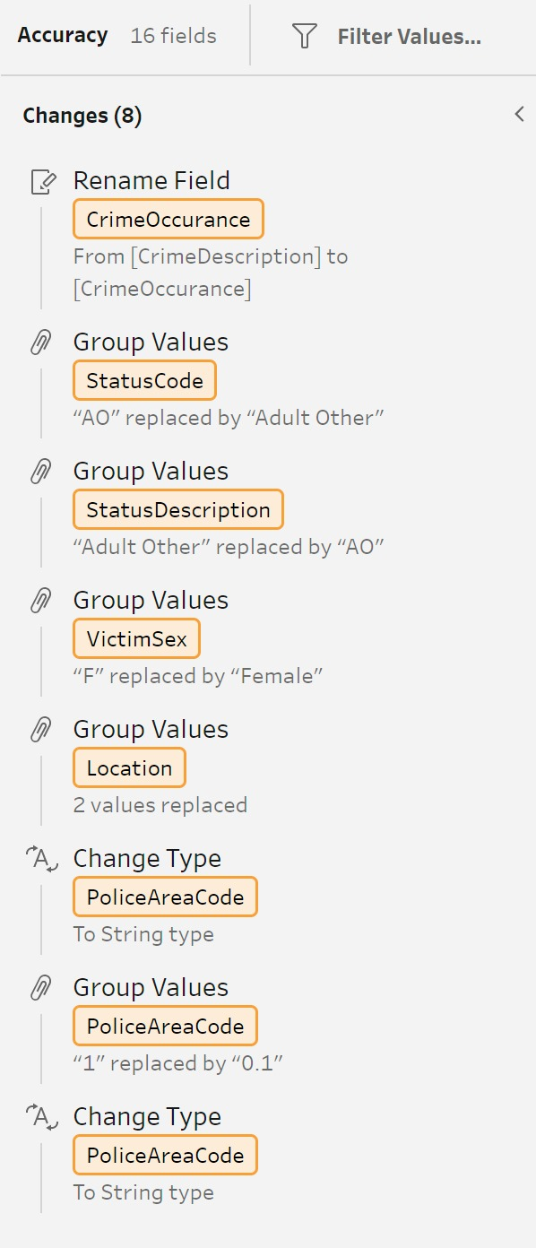
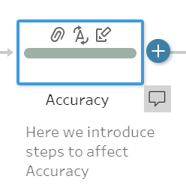
Data Uncleaning
Affecting Accuracy:
-Making sure the column name does not accurately describe the data present under its rows.
-making sure the data present in the row does not accurately represent as to what comes under its Column
Why is this important?
This can mislead users leading to incorrect conclusions and decisions.
TEAM 6
8 March 2024

Slide 32
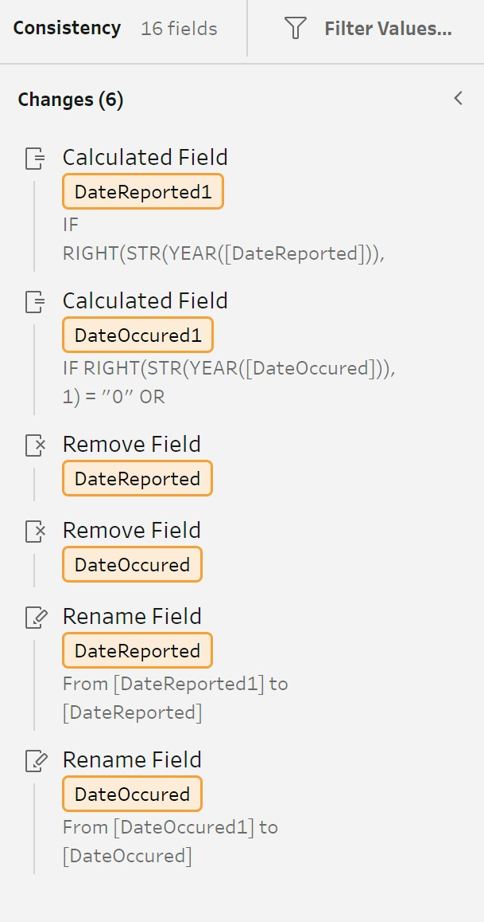
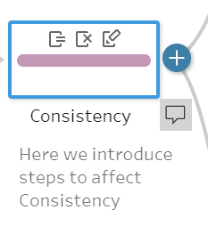
DATA UNCLEANING
Affecting Consistency:
-by changing data types.
Why is this important?
This leads to difficulties in comparison and analysis.
TEAM 6

Slide 33

Conclusion
The cleaning process provides critical insights that can guide the allocation of resources and focus law enforcement efforts.
Conversely, the uncleaning process underscored how data quality issues could obscure these insights.
This exercise underscores the importance of using tools like GCP DataPrep, BigQuery, and Tableau Prep for rigorous data management.
TEAM 6
8 March 2024

Slide 34
Roles
Rakesh and Ashwith - Profiling
Rakesh and Aadishree – Cleaning of the data
Aadishree and Muskaan – Queries
Muskaan and Ashwith – Uncleaning
TEAM 6
8 March 2024

Slide 35
Q&A
12
TEAM 6

